Slide 1
Organizational Culture and Environment by: Lecturer Sanober Tariq

Slide 2
Types of environment
Micro environment
Macro environment

Slide 3
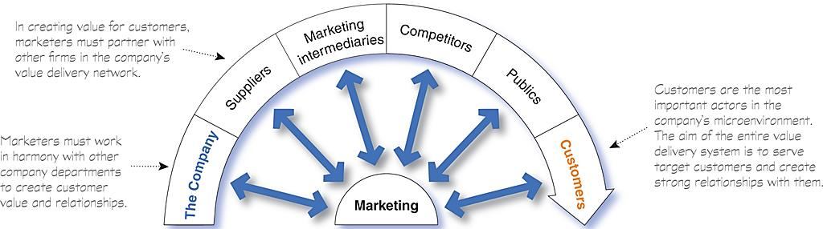
The Microenvironment

Slide 4
The Company
With marketing taking the lead, all departments—from manufacturing and finance to legal and human resources—share the responsibility for understanding customer needs and creating customer value.
Marketing management
Top management
finance
Research and development
purchasing
operations
accounting

Slide 5
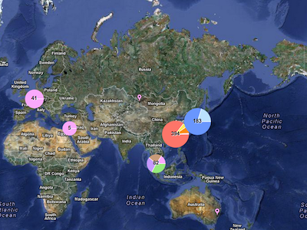

Suppliers
Suppliers provide the resources needed by the company to produce its goods and services.
Most marketers today treat their suppliers as partners in creating and delivering customer value.
Apple’s supplies in the world

Slide 6
Marketing Intermediaries
Marketing intermediaries help the company promote, sell, and distribute its products to final buyers.
Physical distribution firms help the company stock and move goods from their points of origin to their destinations.
Marketing services agencies are the marketing research firms, advertising agencies, media firms, and marketing consulting firms.
Financial intermediaries include banks, credit companies, insurance companies and other businesses that help finance transactions or insure against the risks associated with the buying and selling of goods.

Slide 7



Competitors
Marketers also must gain strategic advantage by positioning their offerings strongly against competitors’ offerings in the minds of consumers.
V.S

Slide 8
Publics
Financial publics
Influences the company’s ability to obtain funds
Banks, investment analysts, and stockholders are the major financial publics.
Citizen-action publics
A company’s marketing decisions may be questioned by consumer organizations, environmental groups, minority groups, and others.
Its public relations department can help it stay in touch with consumer and citizen groups.
A public is any group that has an actual or potential interest in or impact on an organization’s ability to achieve its objectives.
We can identify seven types of publics:
Media publics
Carries news, features, and editorial opinion.
It includes newspapers, magazines, television stations, and blogs and other Internet media.
Internal publics
This group includes workers, managers, volunteers, and the board of directors.
Local Publics
This group includes neighborhood residents and community organizations.
Large companies usually create departments and programs that deal with local community issues and provide community support.
Government Publics
Management must take government developments into account.
Marketers must often consult the company’s lawyers on issues of product safety, truth in advertising, and other matters.
General public
A company needs to be concerned about the general public’s attitude toward its products and activities.
The public’s image of the company affects its buying.

Slide 9
Customers
Consist of individuals and households that buy goods and services for personal consumption.
Consist of these buyers in other countries, including customers, producers, resellers, and governments
The company might target any or all five types of customer markets:
Buy goods and services for further processing or use in their production processes
Consumer markets
Business markets
Reseller markets
Government markets
International markets
Consist of government agencies that buy goods and services to produce public services or transfer the goods and services to others who need them.
Buy goods and services to resell at a profit.

Slide 10
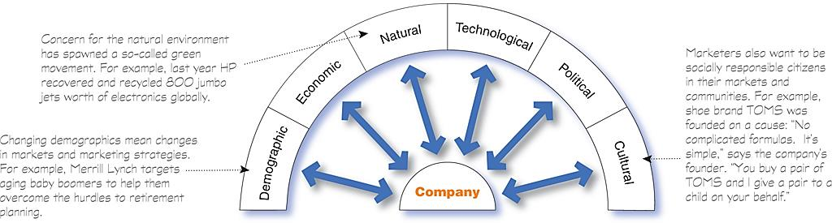
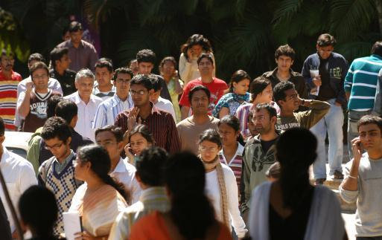

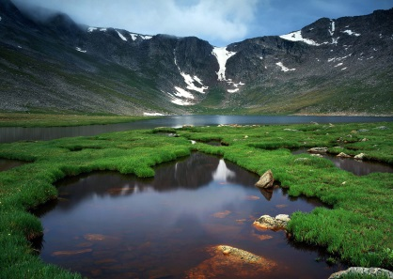


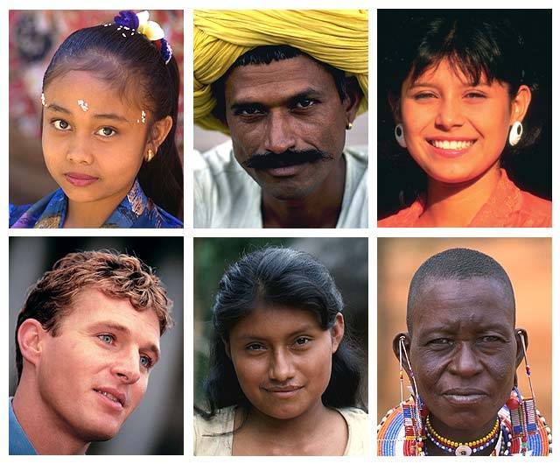
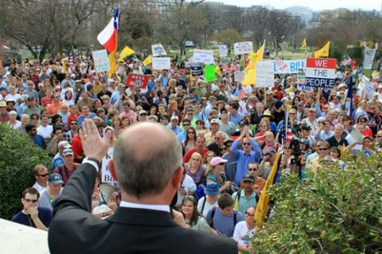
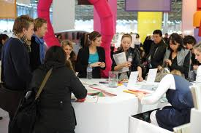

The Macro environment

Slide 11
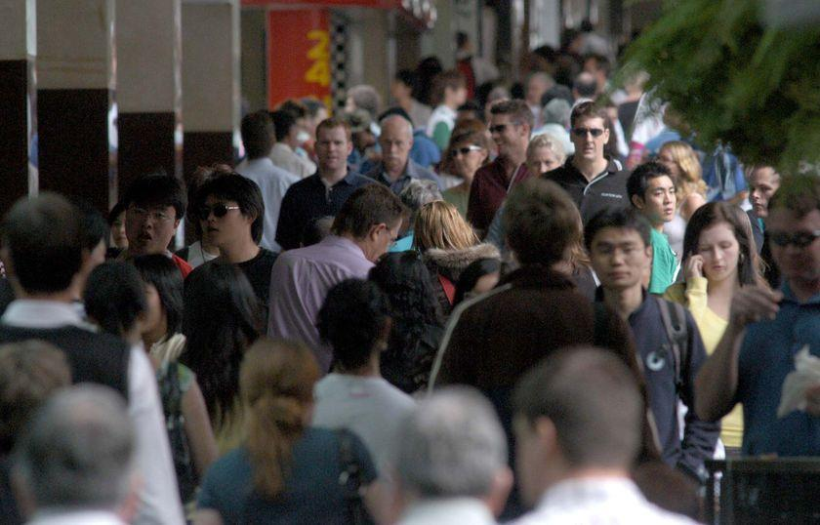
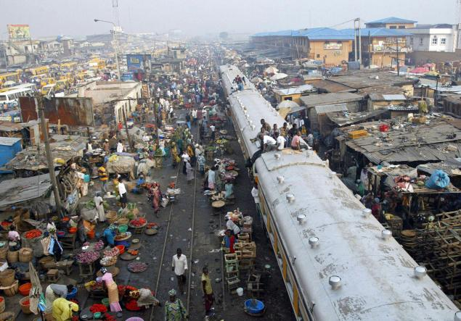
The Demographic Environment
Demography is the study of human populations in terms of size, density, location, age, gender, race, occupation, and other statistics.

Slide 12


Geographic Shifts Population
The shift in where people live has also caused a shift in where they work.
For example, the migration toward micropolitan and suburban areas has resulted in a rapid increase in the number of people who “telecommute”—work at home or in a remote office and conduct their business by phone or the Internet.
This trend, in turn, has created a booming SOHO (small office/home office) market.

Slide 13



A Better-Educated, More White-Collar, More Professional Population
Changes in the Workforce
More educated
More white collar

Slide 14
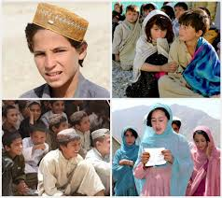
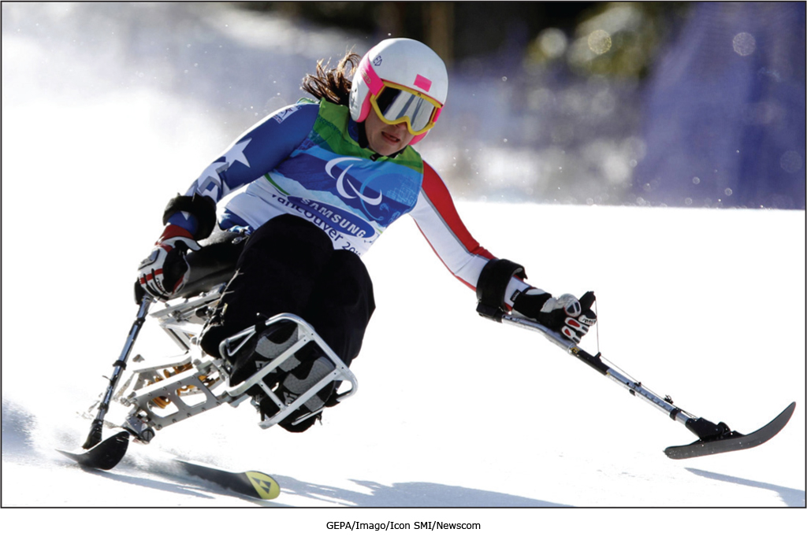

Increasing Diversity
Markets are becoming more diverse
International
National

Slide 15
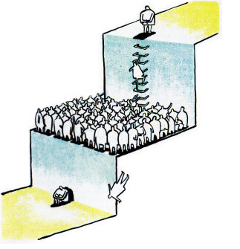
The Economic Environment
The economic environment consists of economic factors that affect consumer purchasing power and spending patterns.
Some countries have industrial economies (developed), which constitute rich markets for many different kinds of goods.
At the other extreme are subsistence economies (under-develop); they consume most of their own agricultural and industrial output and offer few market opportunities.
In between are developing economies that can offer outstanding marketing opportunities for the right kinds of products.

Slide 16

The Natural Environment
The natural environment involves the physical environment and the natural resources that are needed as inputs by marketers or that are affected by marketing activities.
Marketers should be aware of several trends:
Increased shortages of raw materials
Increased pollution
Increased government intervention
The environmental sustainability is the developing strategies and practices that create a world economy that the planet can support indefinitely.

Slide 17
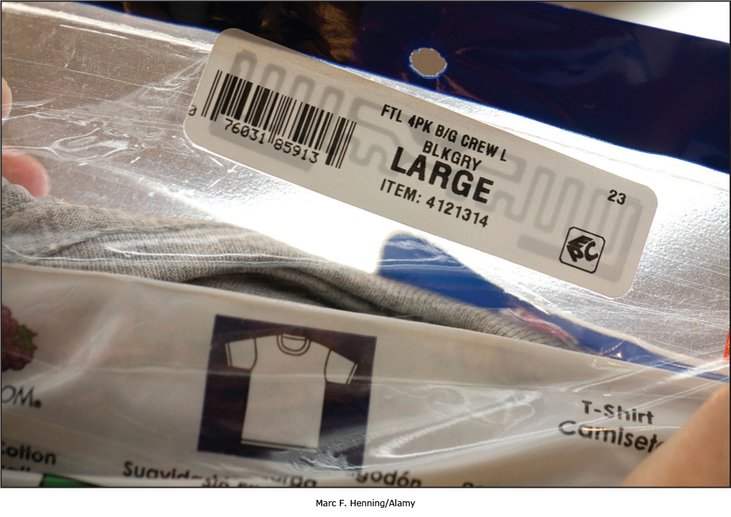


The Technological Environment
The technological environment is perhaps the most dramatic force now shaping our destiny.
Marketers should watch the technological environment closely. Companies that do not keep up will soon find their products outdated. If that happens, they will miss new product and market opportunities.

Slide 18
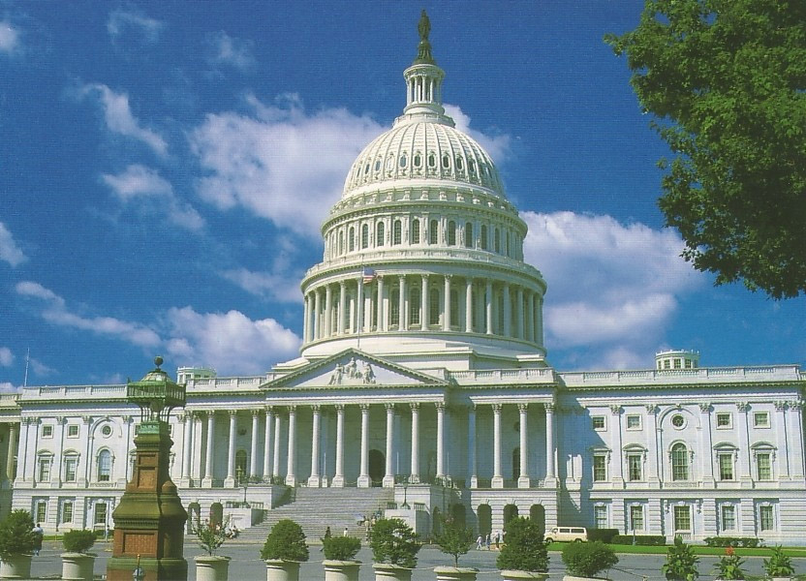
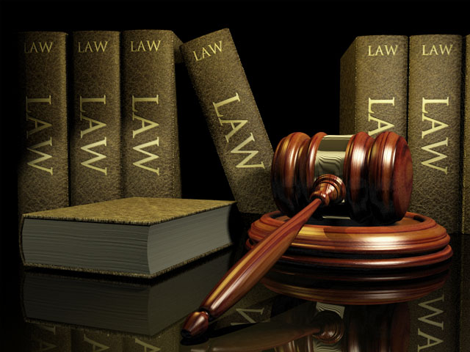
The Political and Social Environment
The political environment consists of laws, government agencies, and pressure groups that influence or limit various organizations and individuals in a given society.

Slide 19

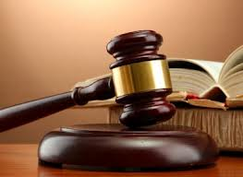
Legislation Regulating Business
Business legislation has been enacted for a number of reasons:
Protect companies from each other
Protect consumers from unfair business practices
Protect the interests of society against unrestrained business behavior.

Slide 20
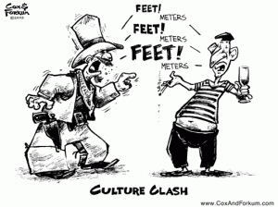
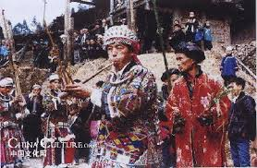

The Cultural Environment
Cultural environment consists of institutions and other forces that affect a society’s basic values, perceptions, preferences, and behaviors

